Slide 1
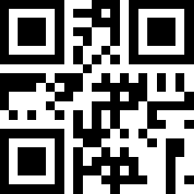
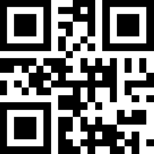
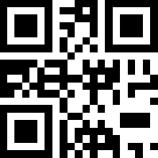
QR Codes for Testing Sample App
Both small and large codes for the three
truck IDs included in the sample Mobile Forms
Cement Truck app for use when testing.
CT-20033-A
CT-42763-B
CT-88103-C
CT-20033-A
CT-42763-B
CT-88103-C

